Slide 1
Innovative test solution
Provider
- Probe pin Datasheet -

Slide 2
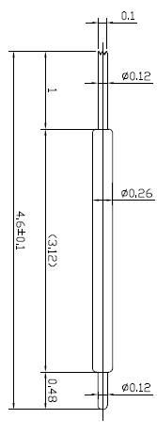
※ General POGO pin – 4.6mm / 0.35P
IVB-DAR-460-026-A053-00
Pitch | 0.35 mm
Total Length | 4.6 mm
Use Length | 4.1 mm
Use Stroke | 0.5 mm
Recommended Top Plunger Stroke | 0.3 mm
Recommended Bottom Plunger Stroke (Pre-load) | 0.2 mm
Max Stroke | 0.6 mm
Spring Force at Use Stroke | 19 gf at 0.5 mm stroke
Operating Temperature | -40 to +140℃
DC Resistance | Avg. 68.5 mΩ at 0.5 mm stroke
Current Rating | 1.0 A
Self Inductance | 1.48 nH
Bandwidth @ -1dB | 9.1 GHz
Top Plunger | BeCu / Au over Ni
Bottom Plunger | BeCu / Au over Ni
Barrel | BeCu / Au over Ni
Spring | SUS / Au
Insertion Life | 100,000 cycles at 0.5 mm stroke

Slide 3
Thank you.

